Slide 1

Basics of Neural Network Programming
Vectorization
deeplearning.ai

Slide 2
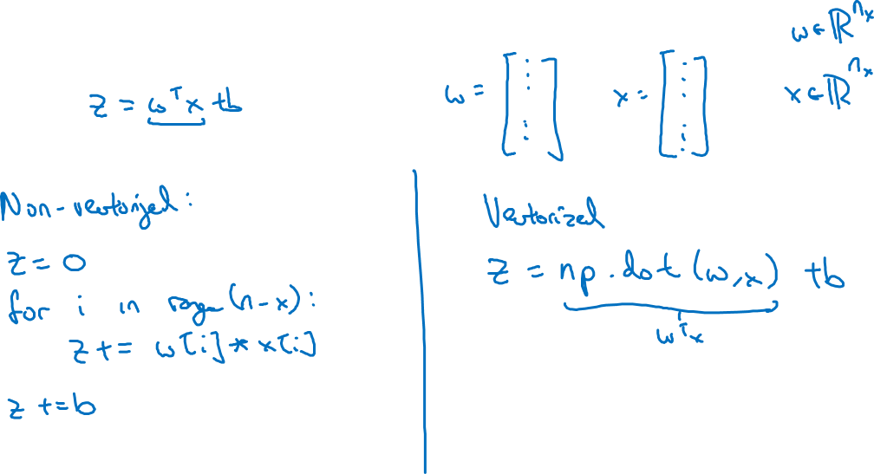
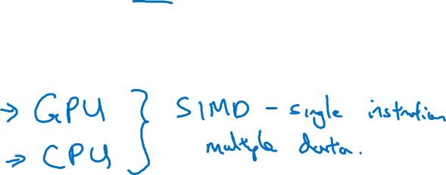
What is vectorization?

Slide 3
Basics of Neural Network Programming
More vectorization
examples
deeplearning.ai

Slide 4
Neural network programming guideline
Whenever possible, avoid explicit for-loops.

Slide 5
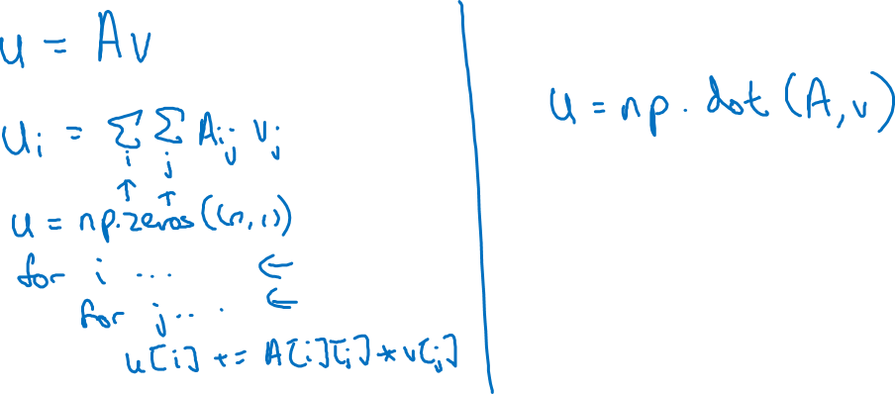
Neural network programming guideline
Whenever possible, avoid explicit for-loops.

Slide 6
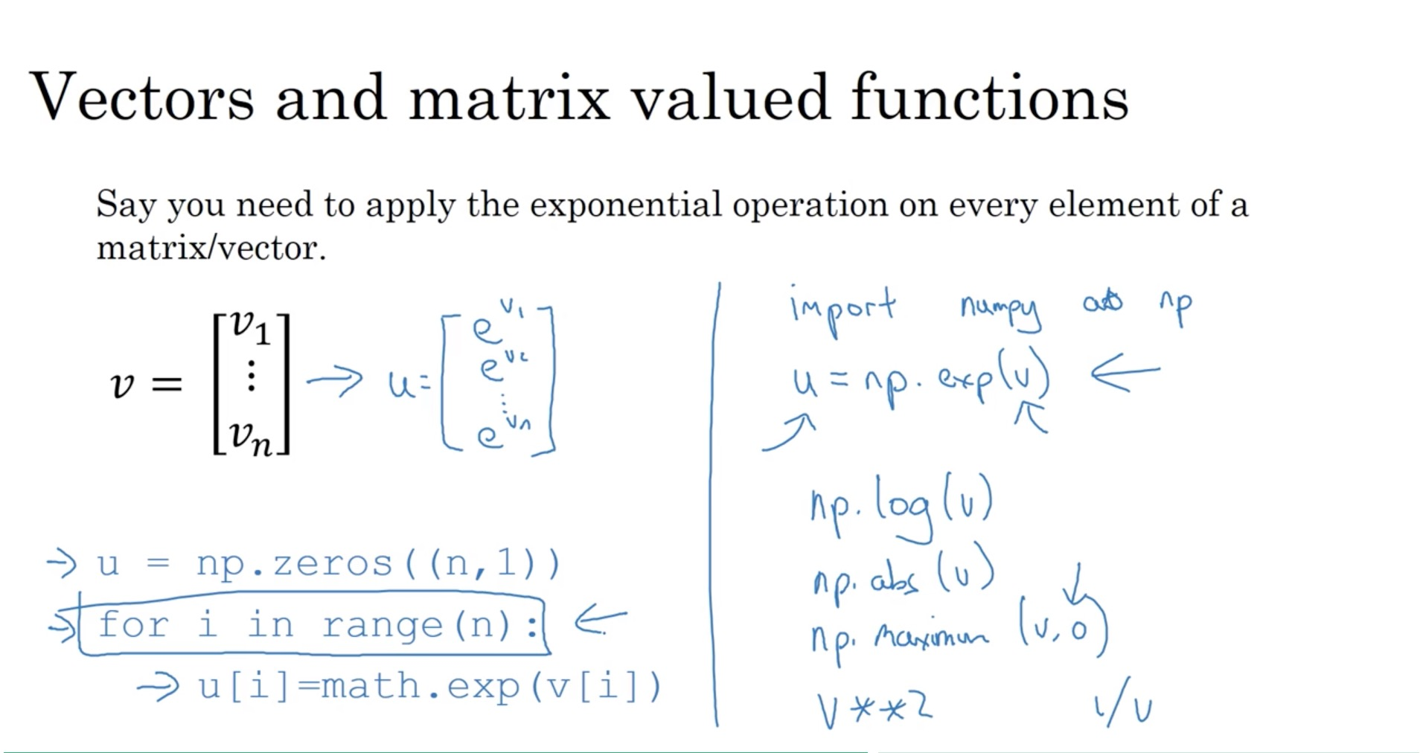

Slide 7
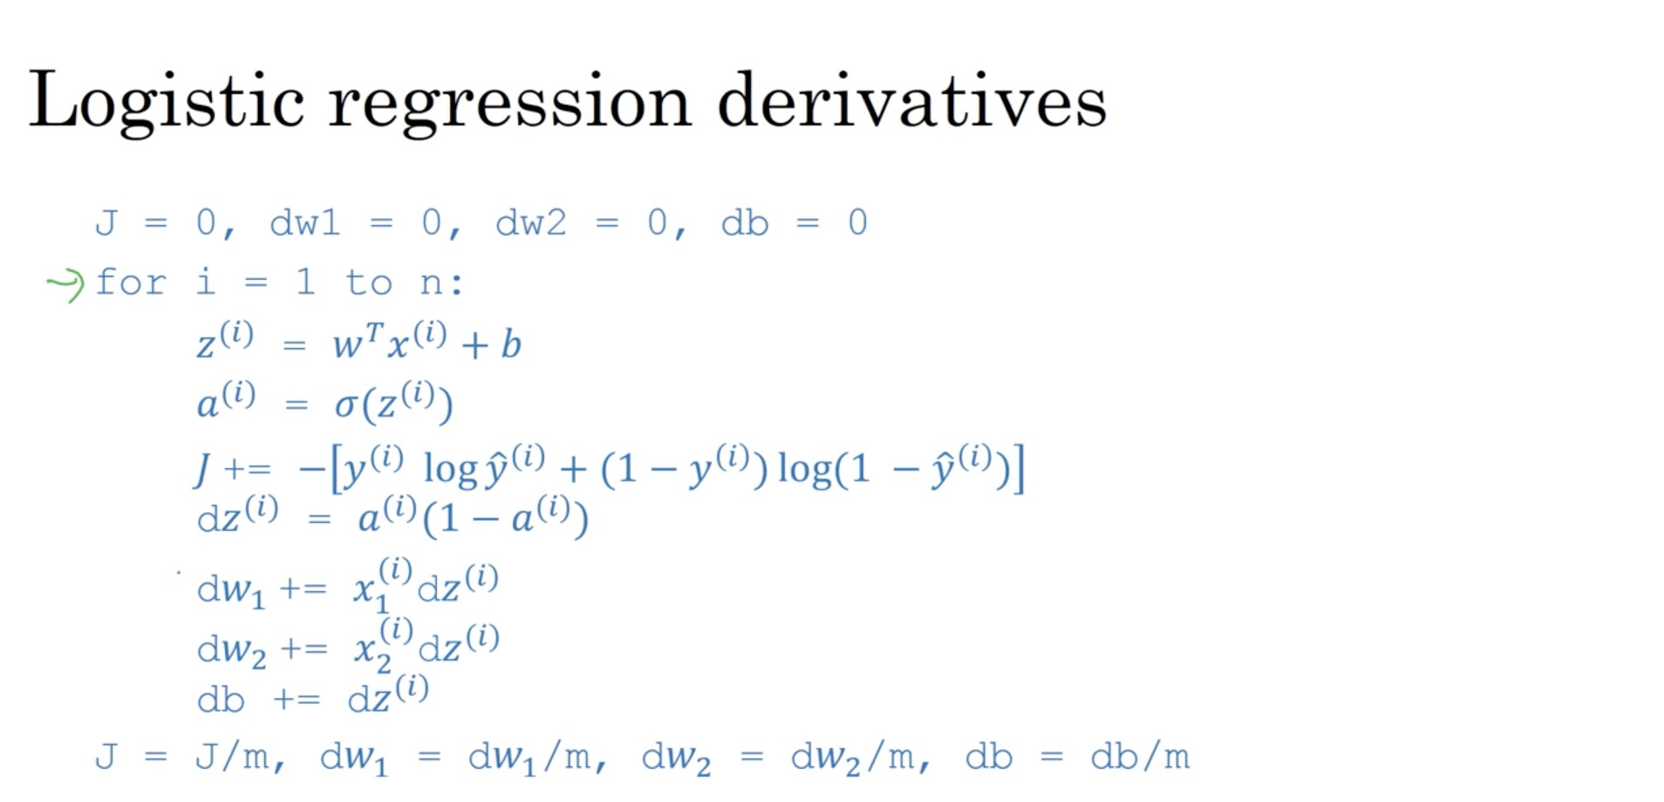

Slide 8
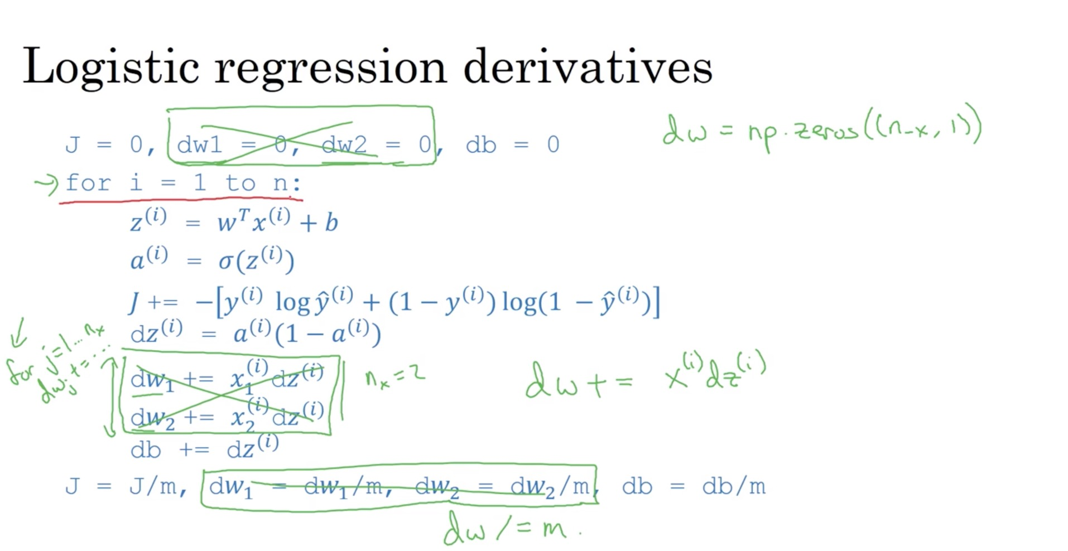

Slide 9
Basics of Neural Network Programming
Vectorizing Logistic
Regression
deeplearning.ai

Slide 10
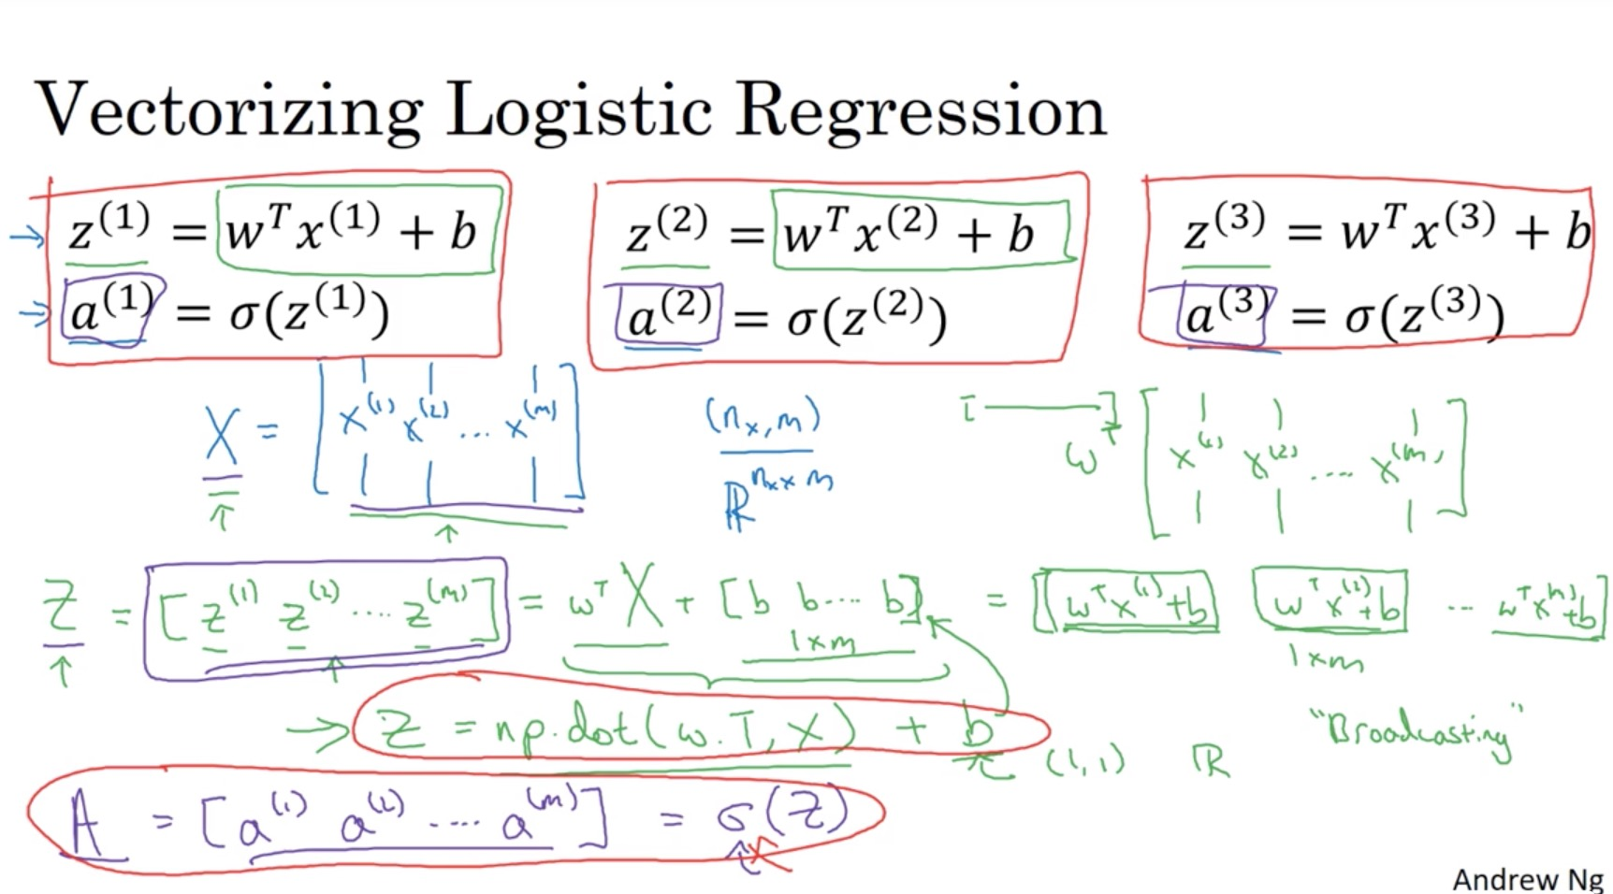

Slide 11
Basics of Neural Network Programming
Vectorizing Logistic
Regression’s Gradient
Computation
deeplearning.ai

Slide 12
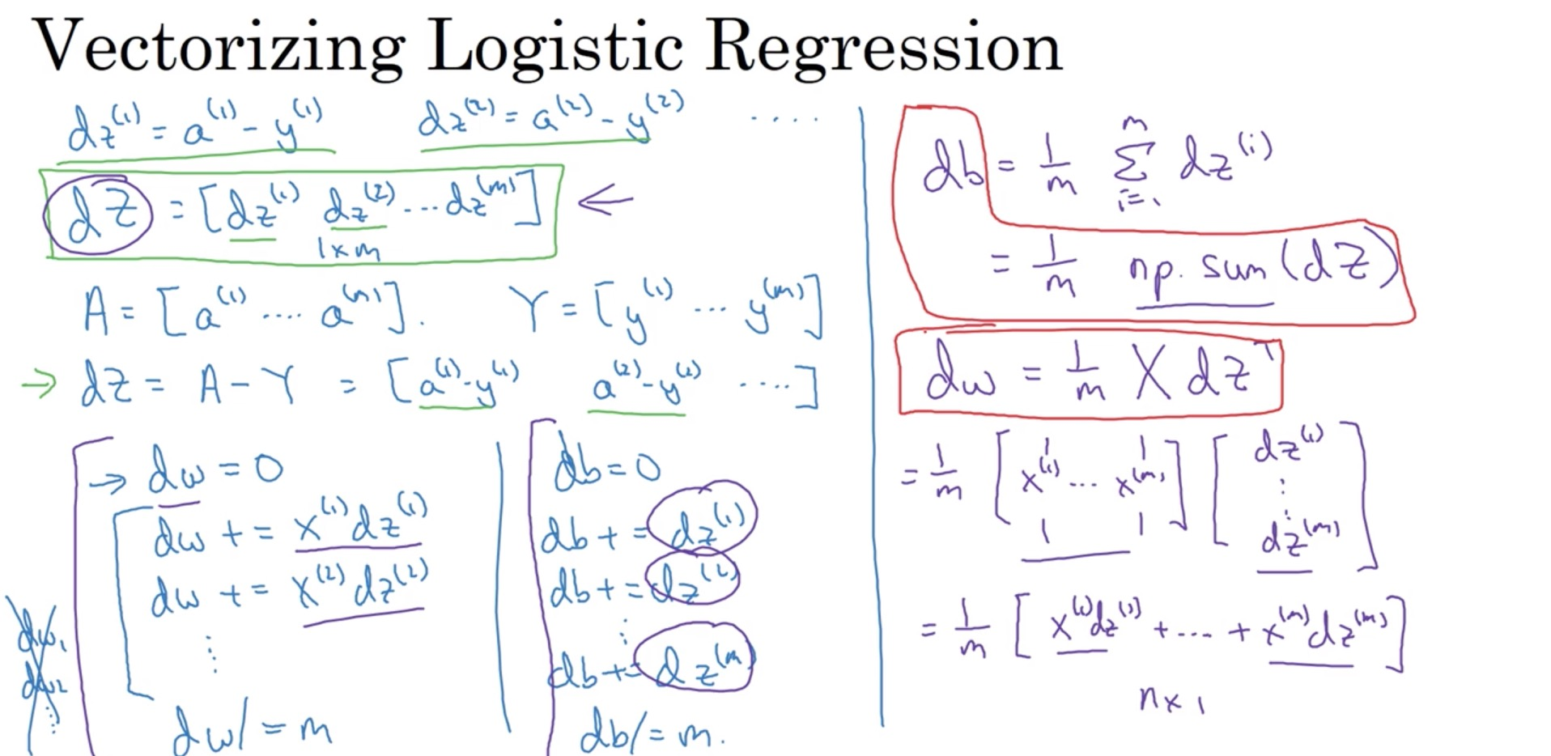

Slide 13
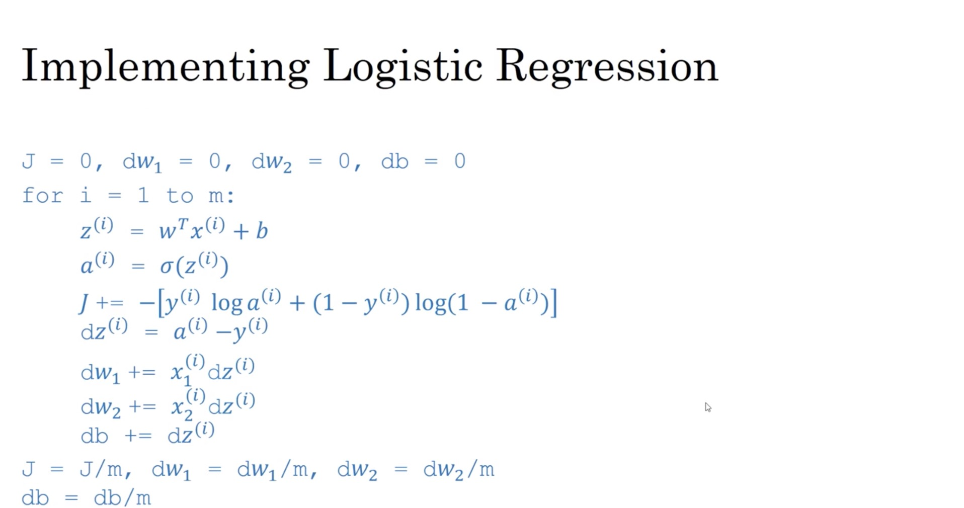

Slide 14
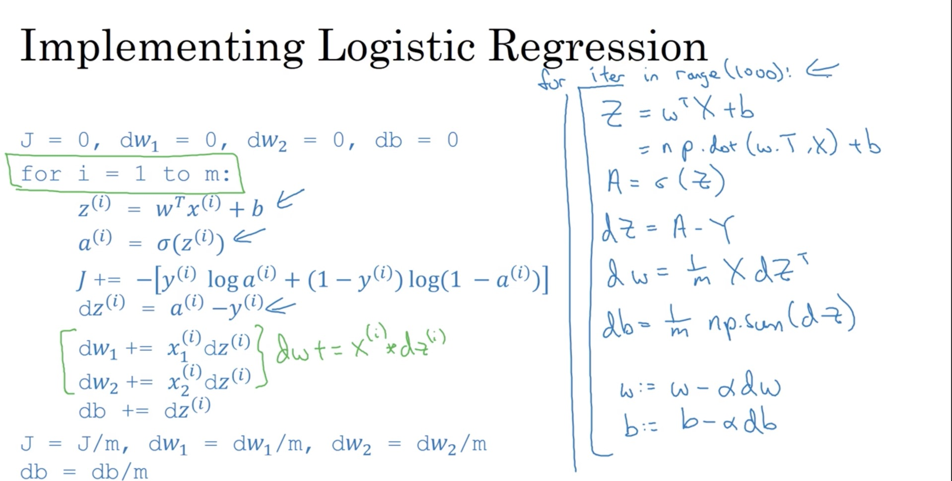

Slide 15
Basics of Neural Network Programming
Broadcasting in
Python
deeplearning.ai

Slide 16
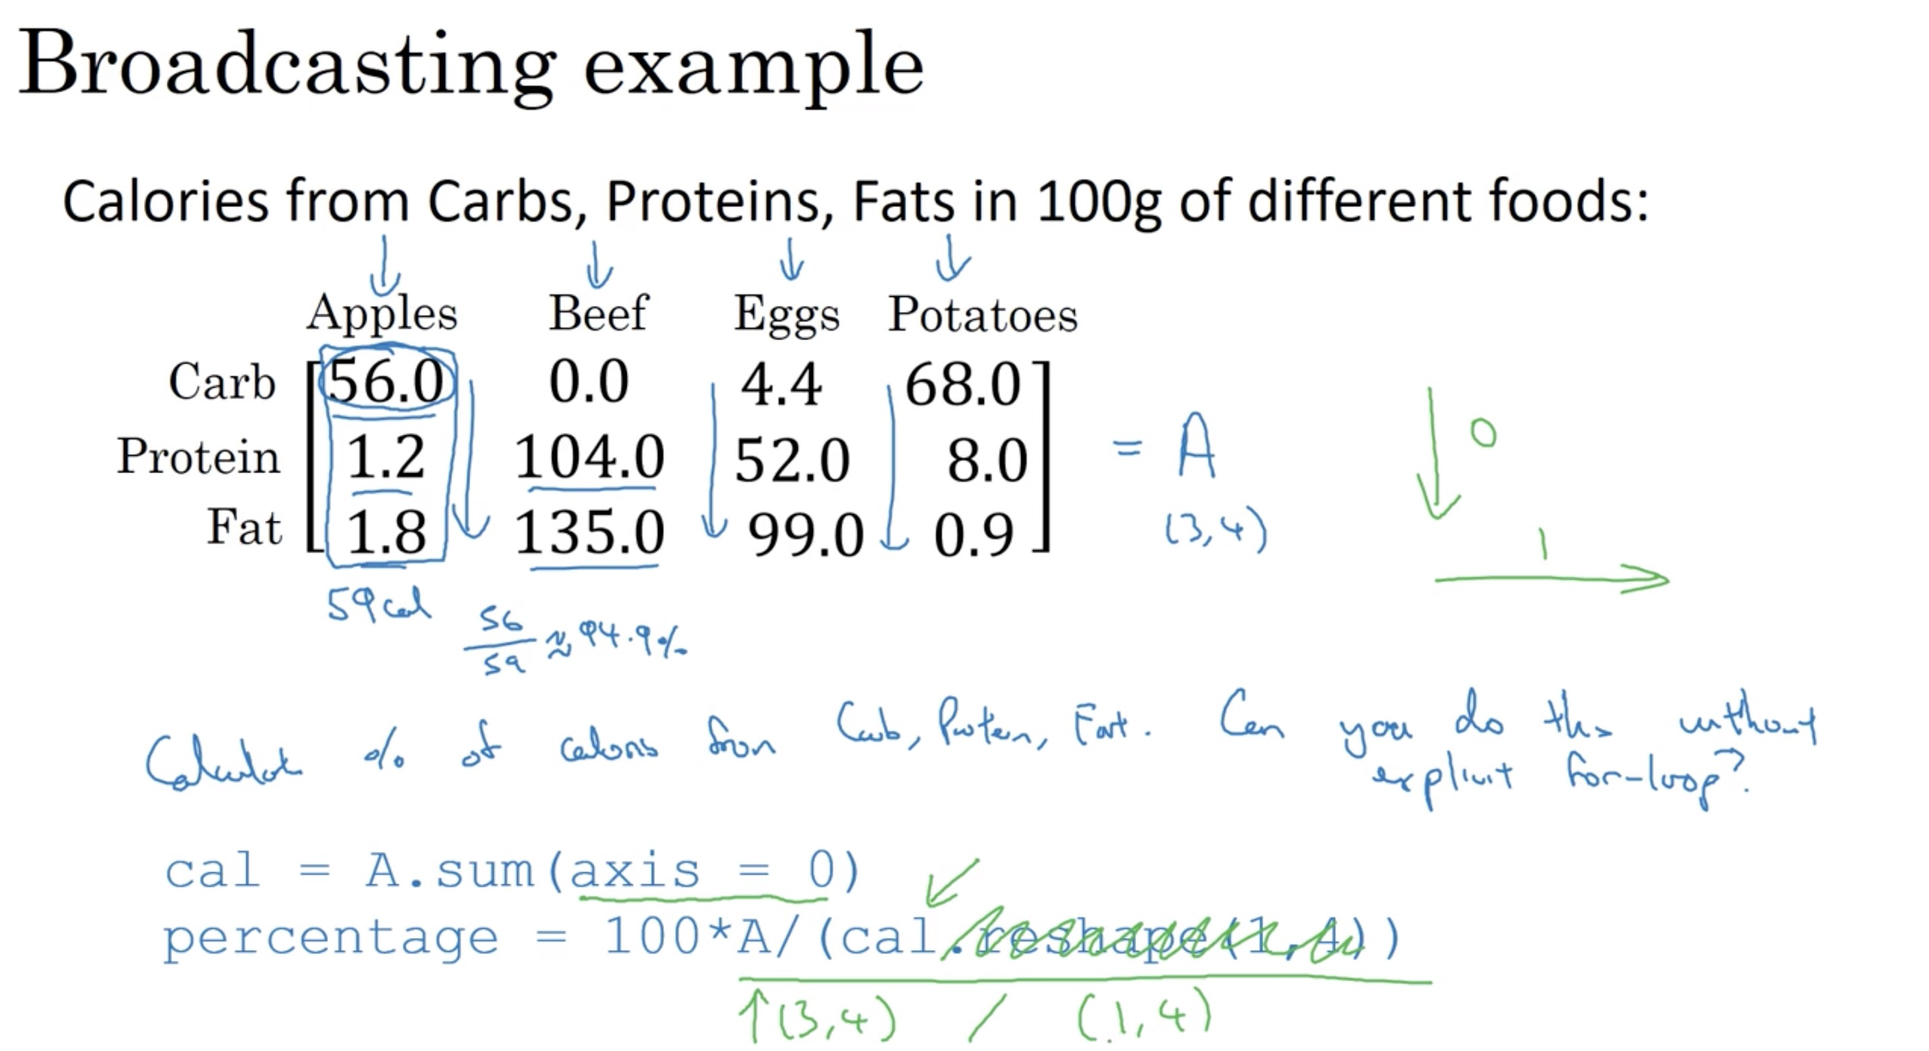

Slide 17
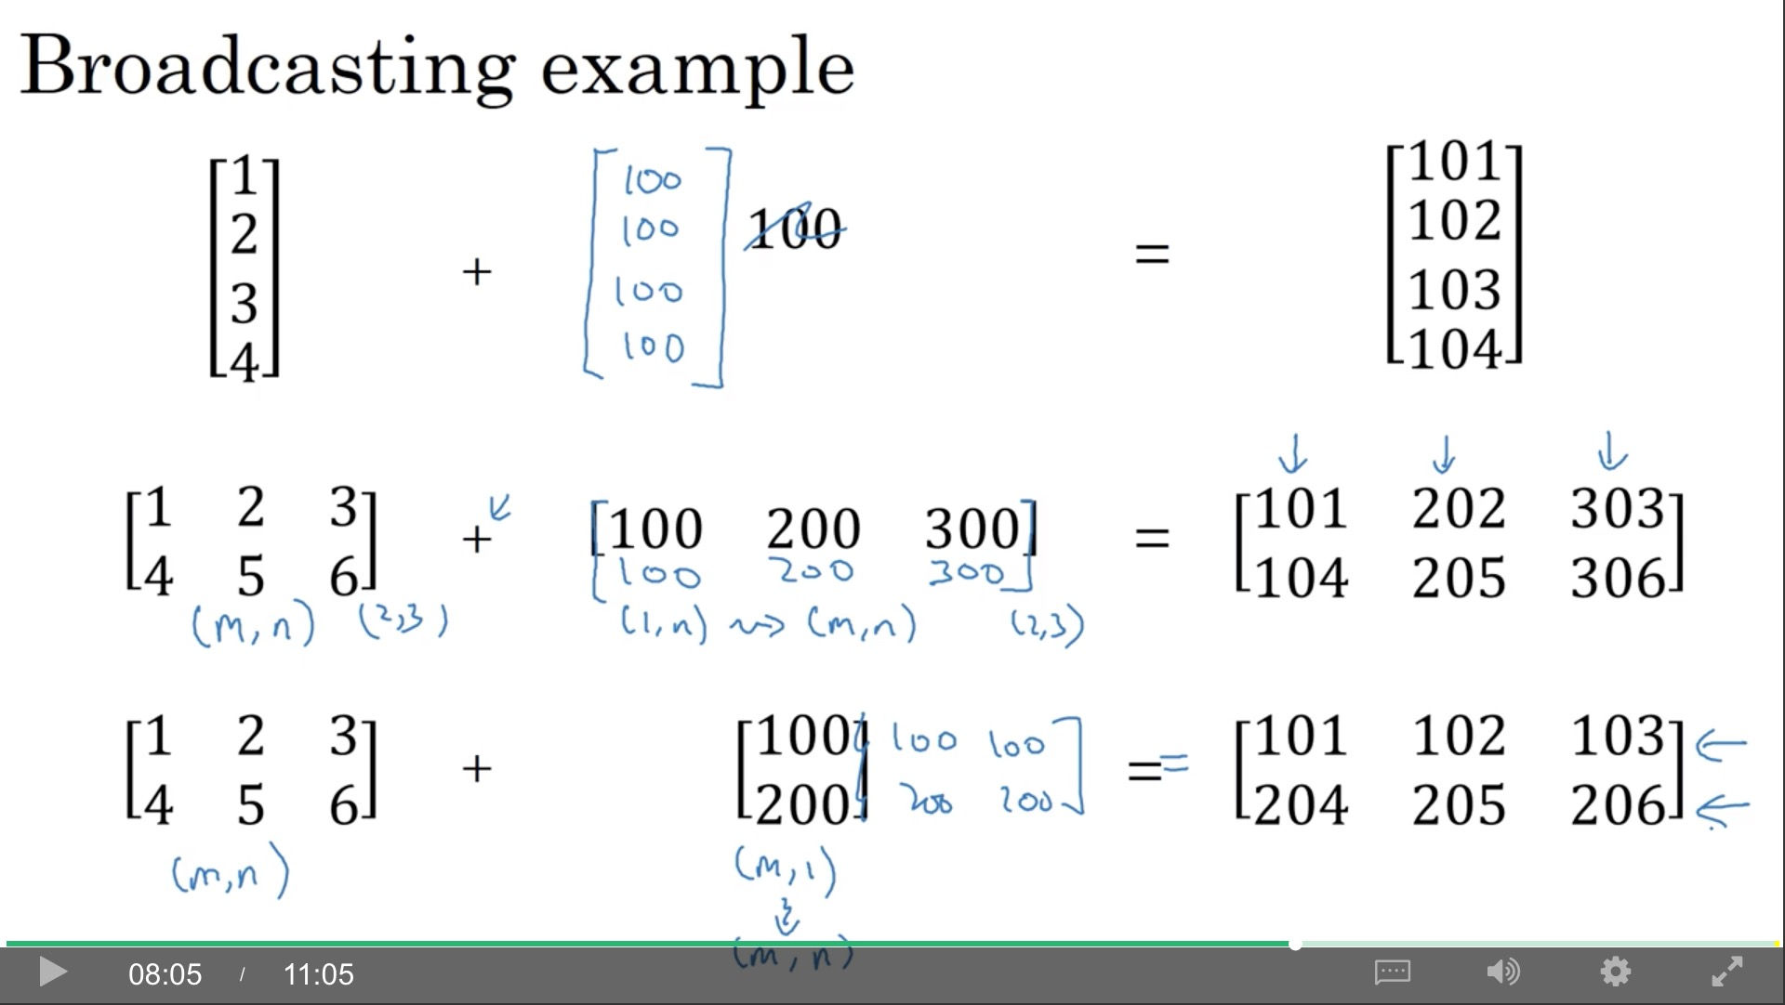

Slide 18
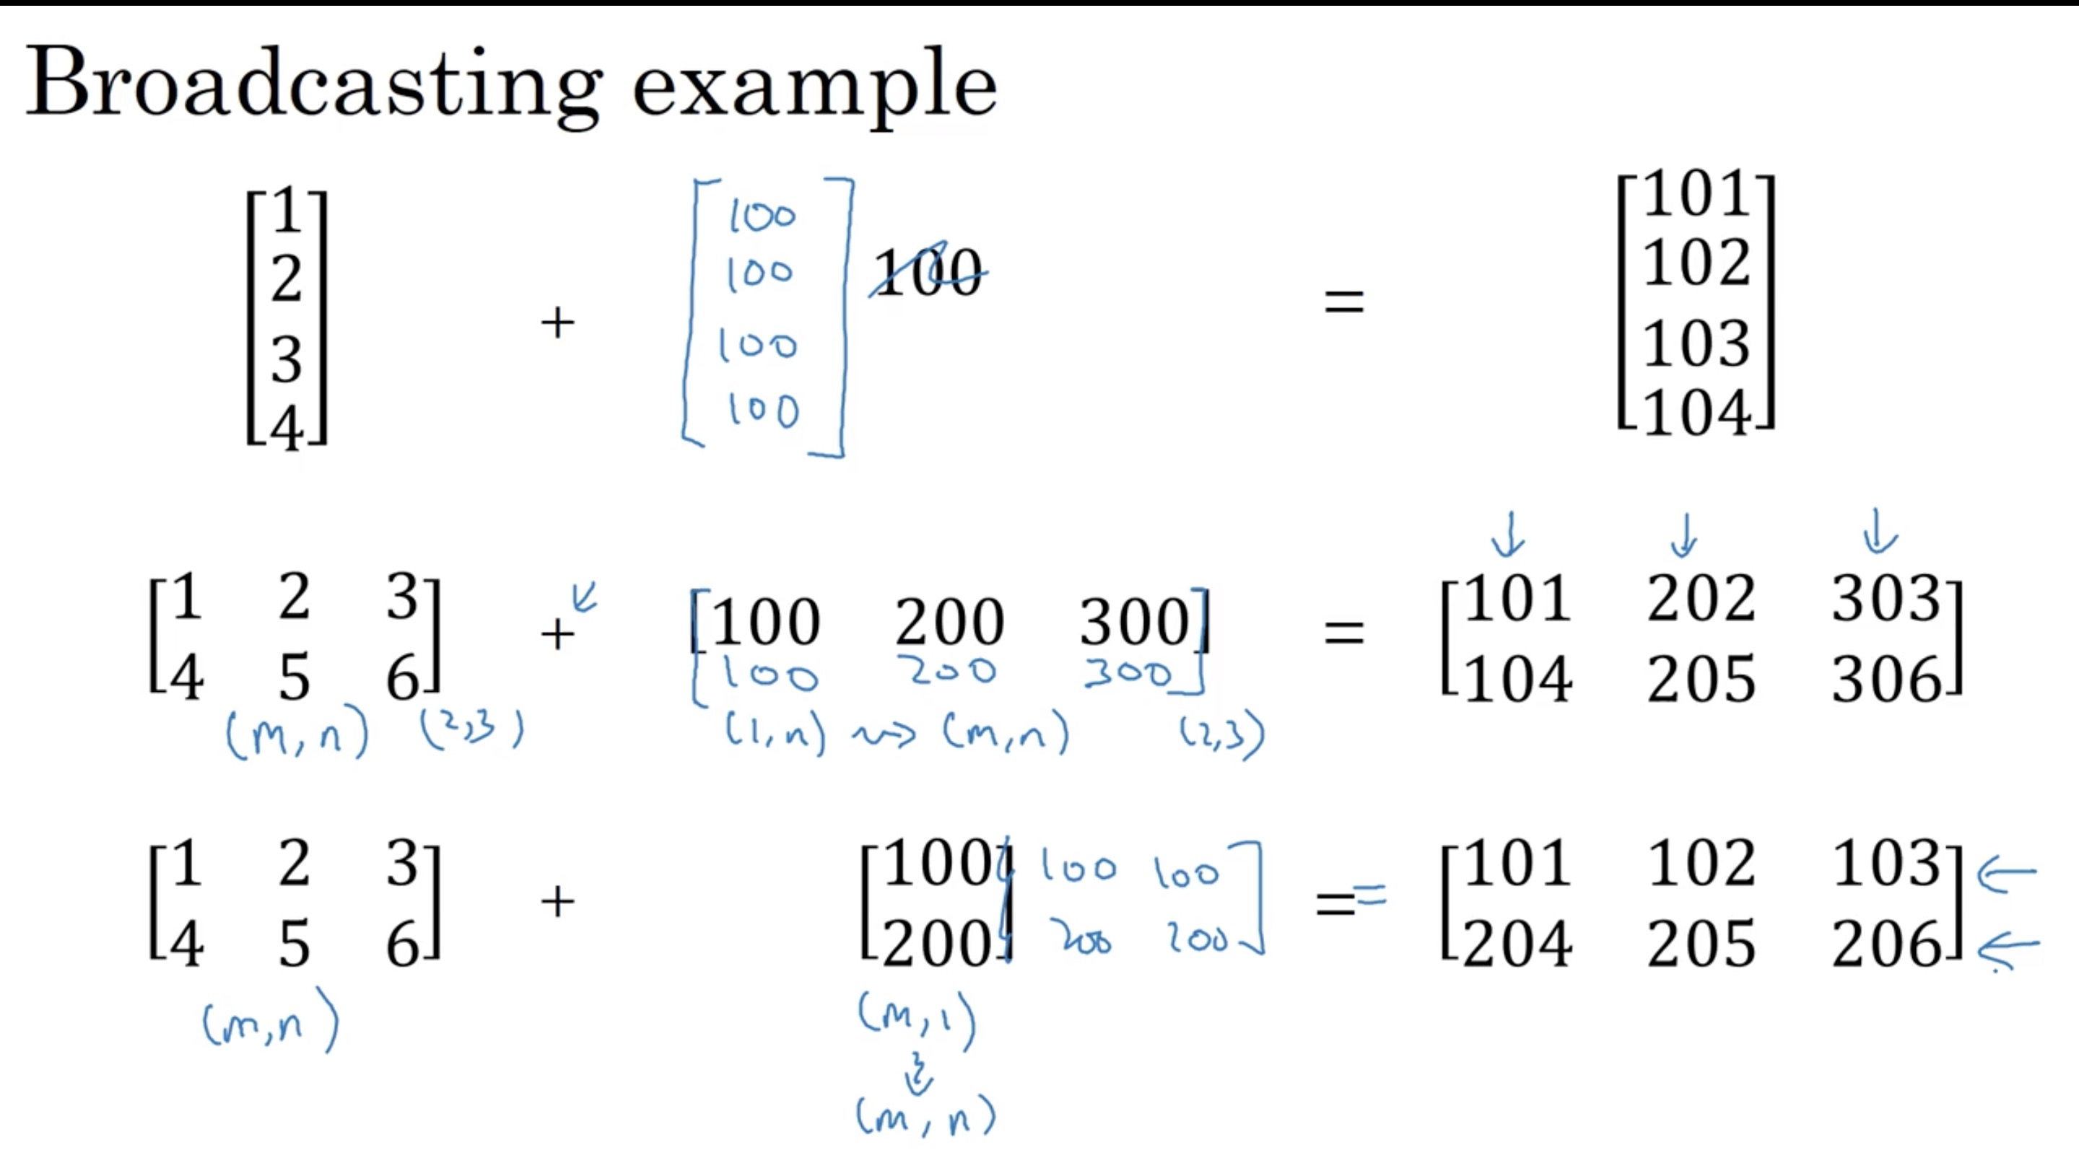

Slide 19
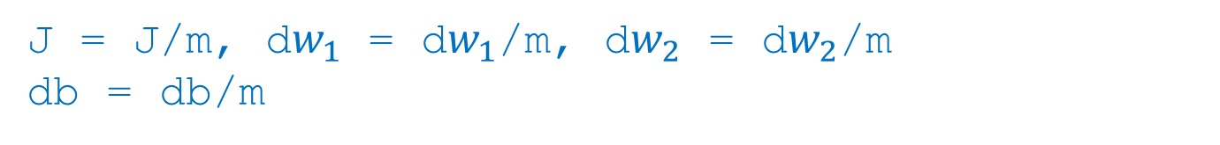
General Principle

Slide 20
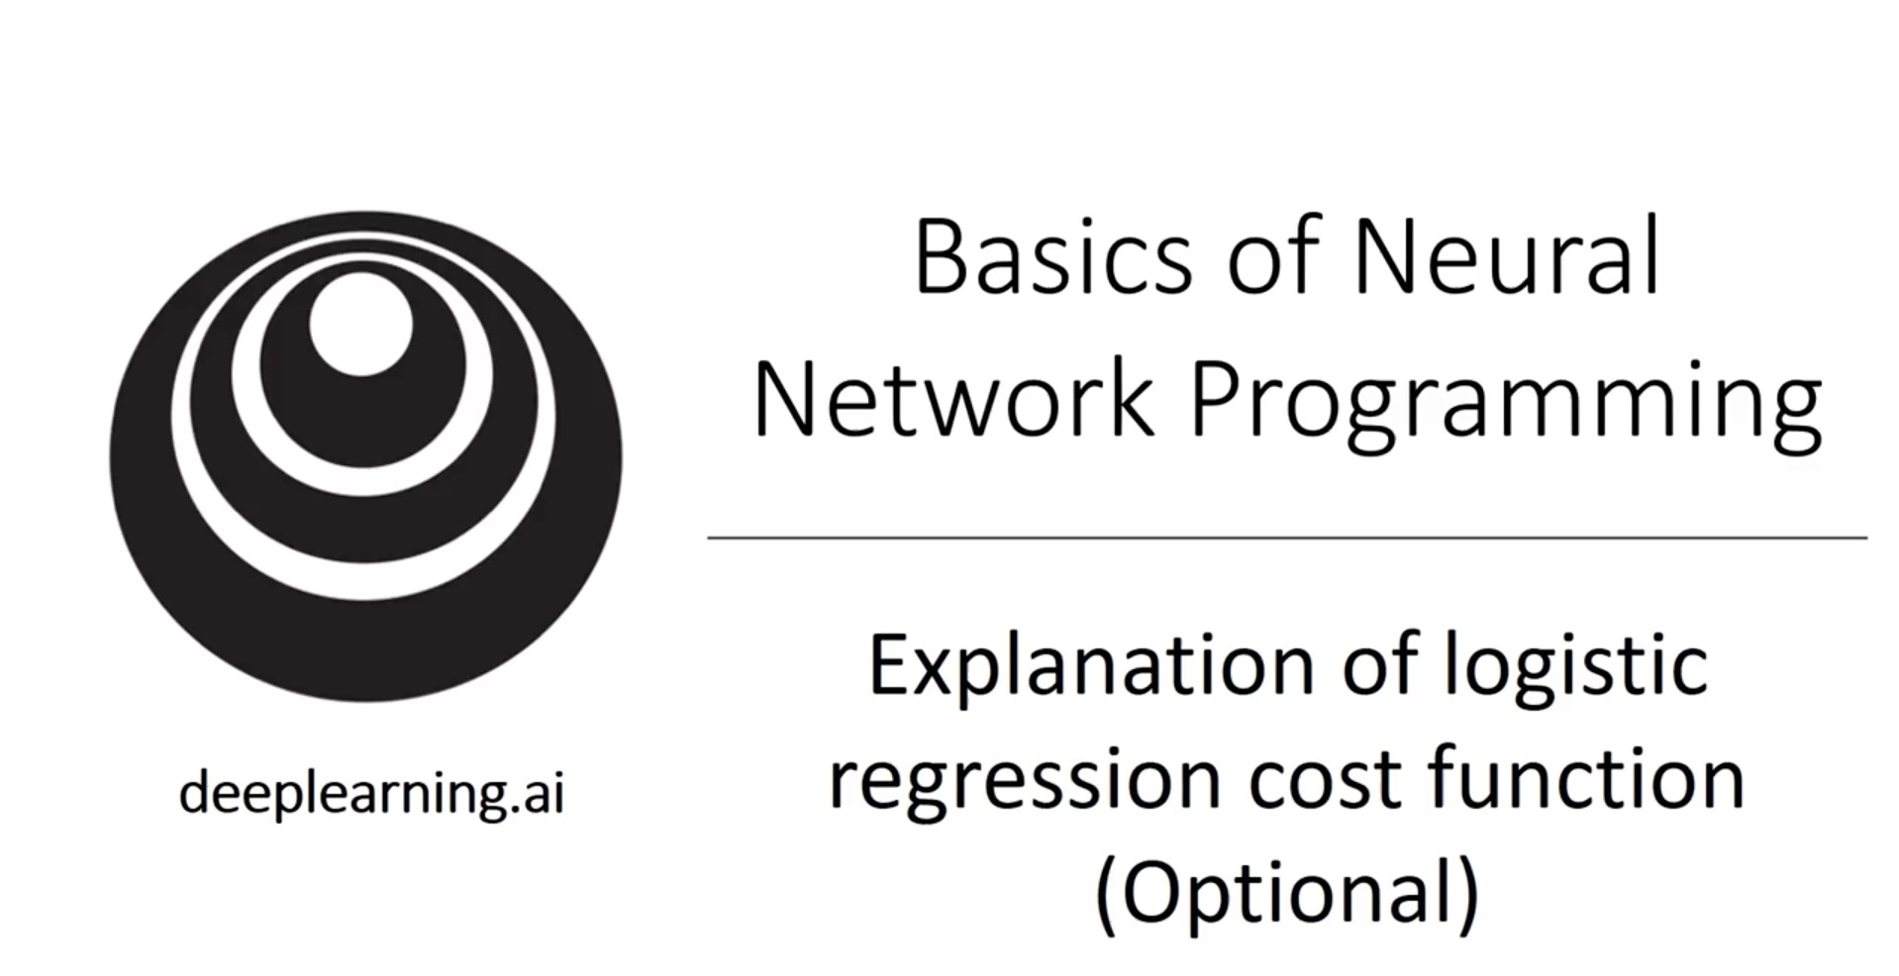

Slide 21
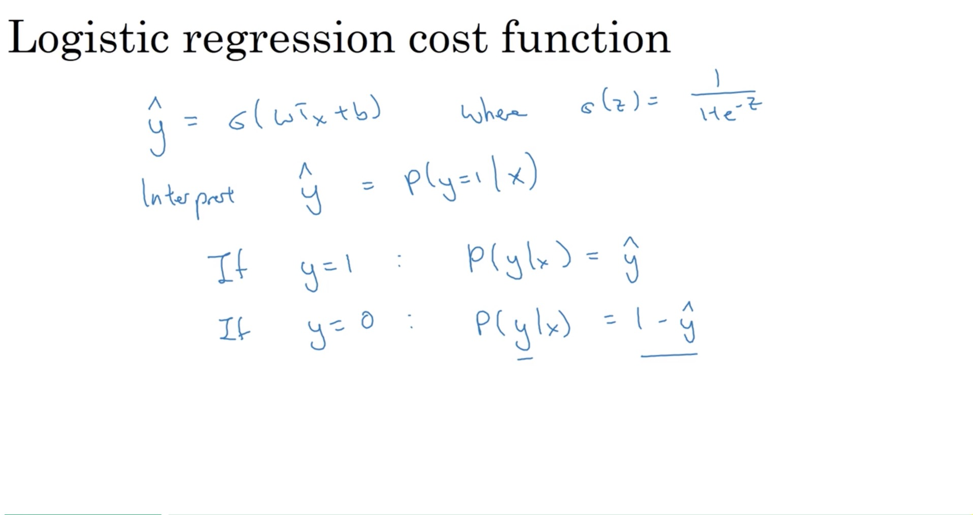

Slide 22
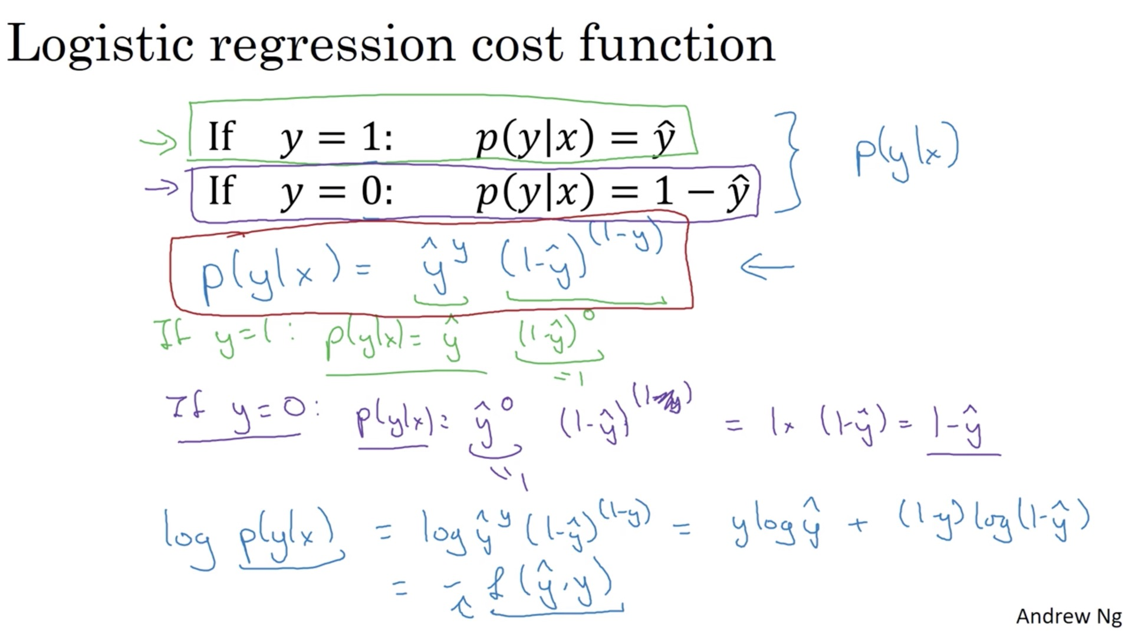
Best fit one training record, means Maximum this
Best fit one training record, also means Minimize loss function L

Slide 23
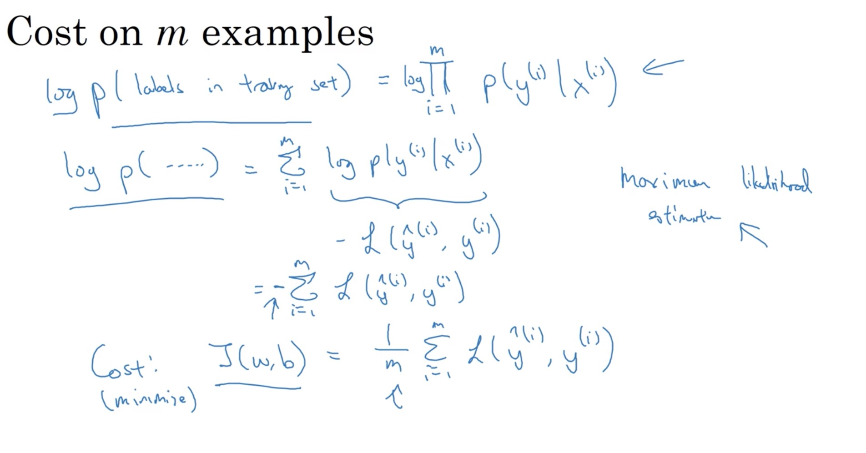
Best fit training set, means Minimize cost function J

